Slide 1
mental health app MindBody
Team 01
2YB
JEEBITHA JJ 2022SP93076
SRIVALLI P 2022SP93014
SIMRAN KRISHNA 2022SP93047

Slide 2
Agenda
Project Details
Architecture/Design
Screenshots
Challenges
Interesting Points

Slide 3
Project Details
Problem
Many individuals struggle to maintain a healthy lifestyle, facing challenges such as weight management, emotional well-being, and staying motivated to achieve personal goals. The health issues are prevalent affecting millions of individuals worldwide. This can lead to prolonged struggles with mental health conditions, hindering personal growth, productivity, and overall quality of life.

Slide 4
Project Details
Solution
MindBody is a health app that addresses the challenges of managing well-being by providing a comprehensive suite of tools for self-monitoring, goal setting, and emotional reflection. Our application aims to empower users in their journey towards a healthier and more fulfilling life. By offering a suite of features, the application becomes a one-stop solution for individuals seeking to enhance their overall well-being.

Slide 5
Project Details
Purpose
Enhance Self-Awareness: By enabling users to track their moods, identify patterns, and reflect on their emotional experiences, MindBody fosters a deeper understanding of one's mental state.
Empower Goal-Setting: The app's goal-setting feature encourages users to establish personalized objectives that align with their mental health aspirations, providing a sense of direction and motivation.
Promote Mindful Practices: Journaling within MindBody cultivates mindfulness and self-reflection, allowing individuals to process their thoughts, feelings, and experiences in a safe and private space.
License
This project is licensed under the MIT License.

Slide 6
Project Details
Features
BMI Calculator: Allows users to effortlessly calculate their Body Mass Index (BMI) within the app. This feature helps in monitoring health and tracking changes in body composition to encourage a healthier lifestyle.
Mood Tracker: Enables users to monitor their emotions and moods daily through an intuitive tracker. It helps visualize patterns and gain insights into emotional well-being over time, fostering self-awareness.
Journaling: Provides a platform for users to express themselves freely through daily journal entries. It allows them to record thoughts, feelings, and experiences, promoting self-reflection and introspection.
Goal Setting: Allows users to set and manage personal goals within the app. It facilitates staying motivated and organized by tracking progress towards individual milestones.
Additional feature
Social Login using email authentication & Google Sign In.

Slide 7
Architecture
Framework and Structure
MindBody is built upon a modular and scalable architecture that facilitates maintainability and adaptability. The app's core components are organized into distinct modules, each with well-defined responsibilities and interfaces. Additionally, the app employs a client-server architecture, separating the user interface (UI) from the backend logic.

Slide 8

Design

Slide 9
Design
Technologies
Front-end: The app's UI is built using Flutter Dart. It enables developers to build natively compiled applications for mobile, web, and desktop from a single codebase, fostering efficient and expressive cross-platform development.
Back-end: The app's backend logic is primarily handled by Firebase. Firebase uses Google Cloud's backend infrastructure for authentication, providing a secure and scalable authentication solution for applications. Leveraging features like Firebase Authentication, developers can implement user sign-up, sign-in, and identity management seamlessly, with support for various authentication providers and methods.

Slide 10
Design
Tools
Version Control: Git is used as the version control system to track changes in the codebase and facilitate collaboration among developers.
Code Linting: ESLint and Prettier are used to enforce consistent code style and ensure code quality.
User Testing: User testing sessions are regularly conducted to gather feedback and identify areas for improvement in the app's design and usability.
Cross-platform testing: We have emulators(android devices) and simulators (iOS devices) to efficiently evaluate how our application performs across diverse devices and operating systems, ensuring seamless functionality without the need for physical testing on each platform.
Methodologies:
User Research: User research methods, such as surveys, are employed to understand user needs, pain points, and expectations.
User Personas: User personas are created to represent different types of users and their mental health goals, guiding design decisions and ensuring the app caters to diverse user needs.
Usability Testing: Usability testing is conducted to evaluate the app's ease of use, identify usability issues, and refine the user interface.
Iterative Design: The development process follows an iterative approach, incorporating user feedback and insights at each stage to continuously improve the app's design and functionality.

Slide 11
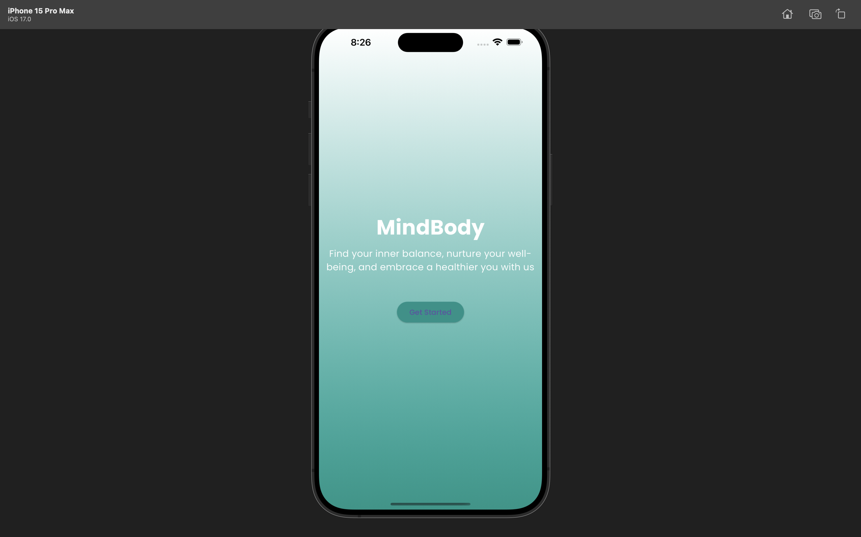
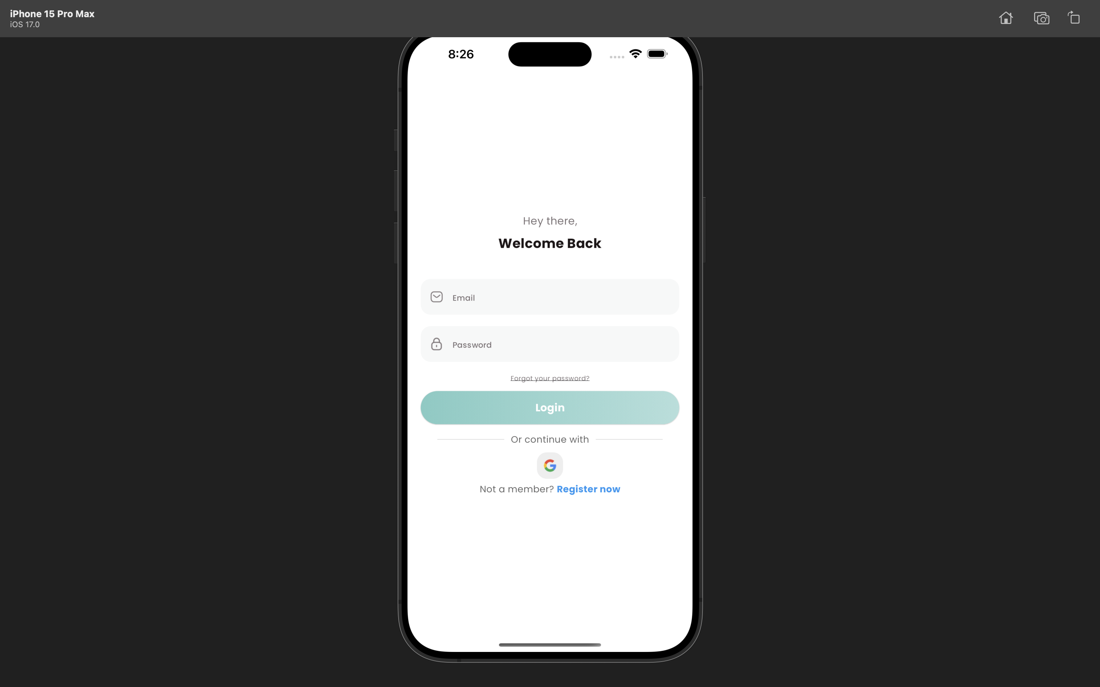
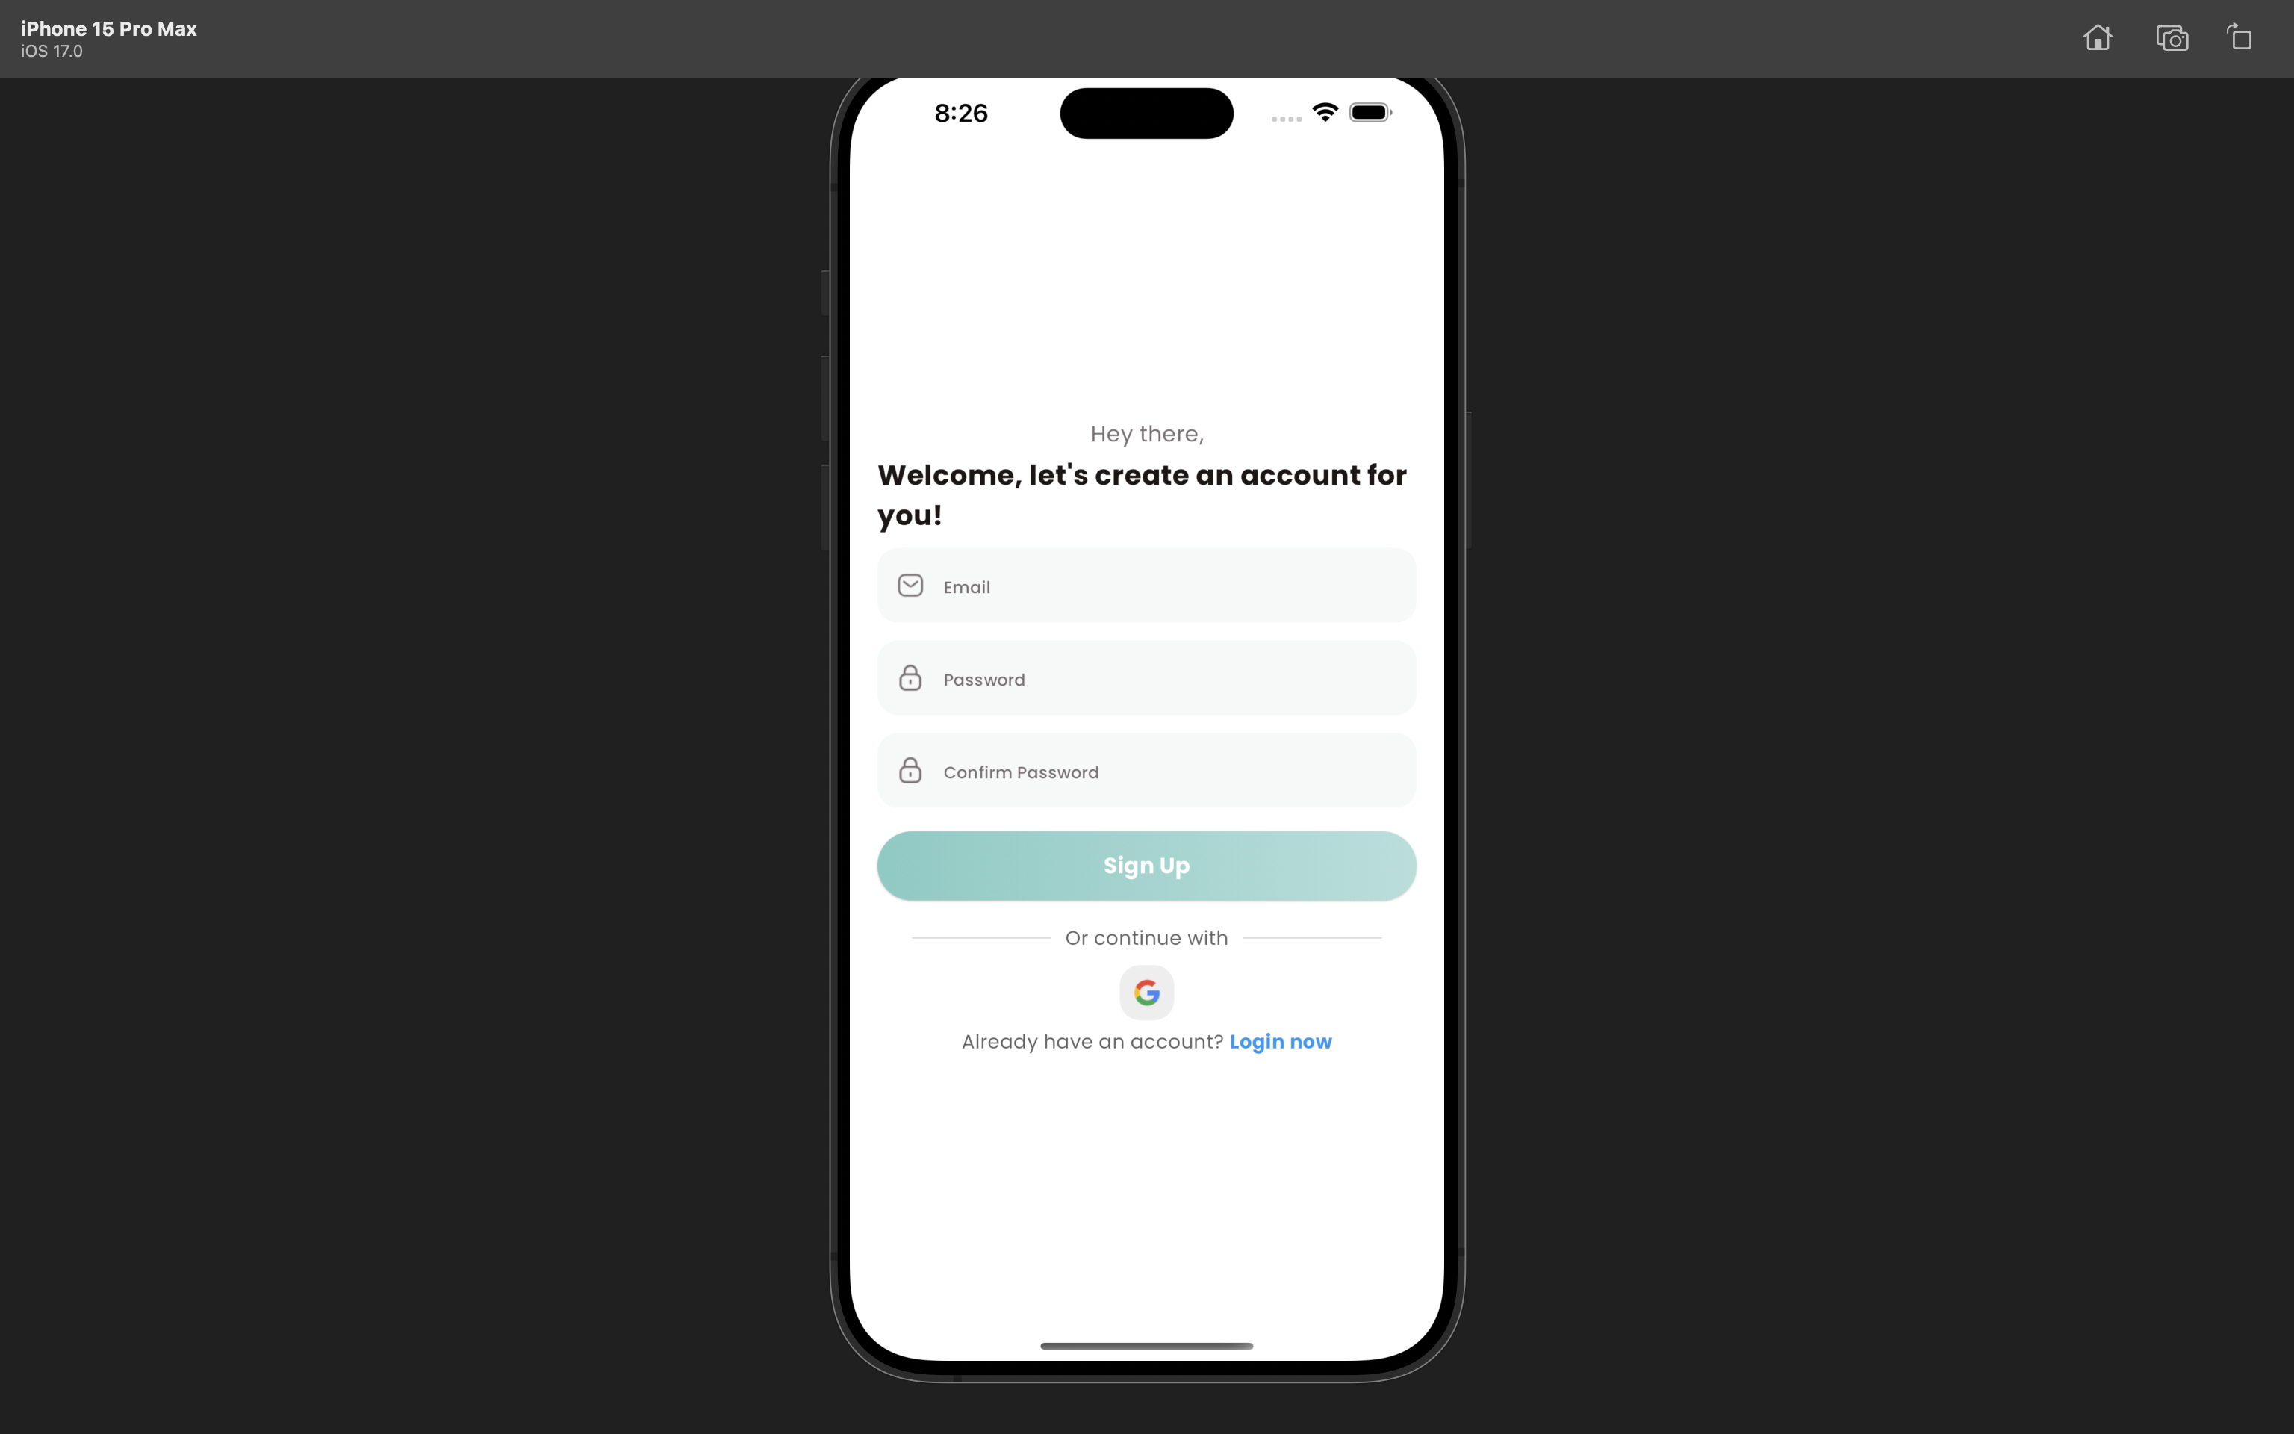
Screenshots

Slide 12
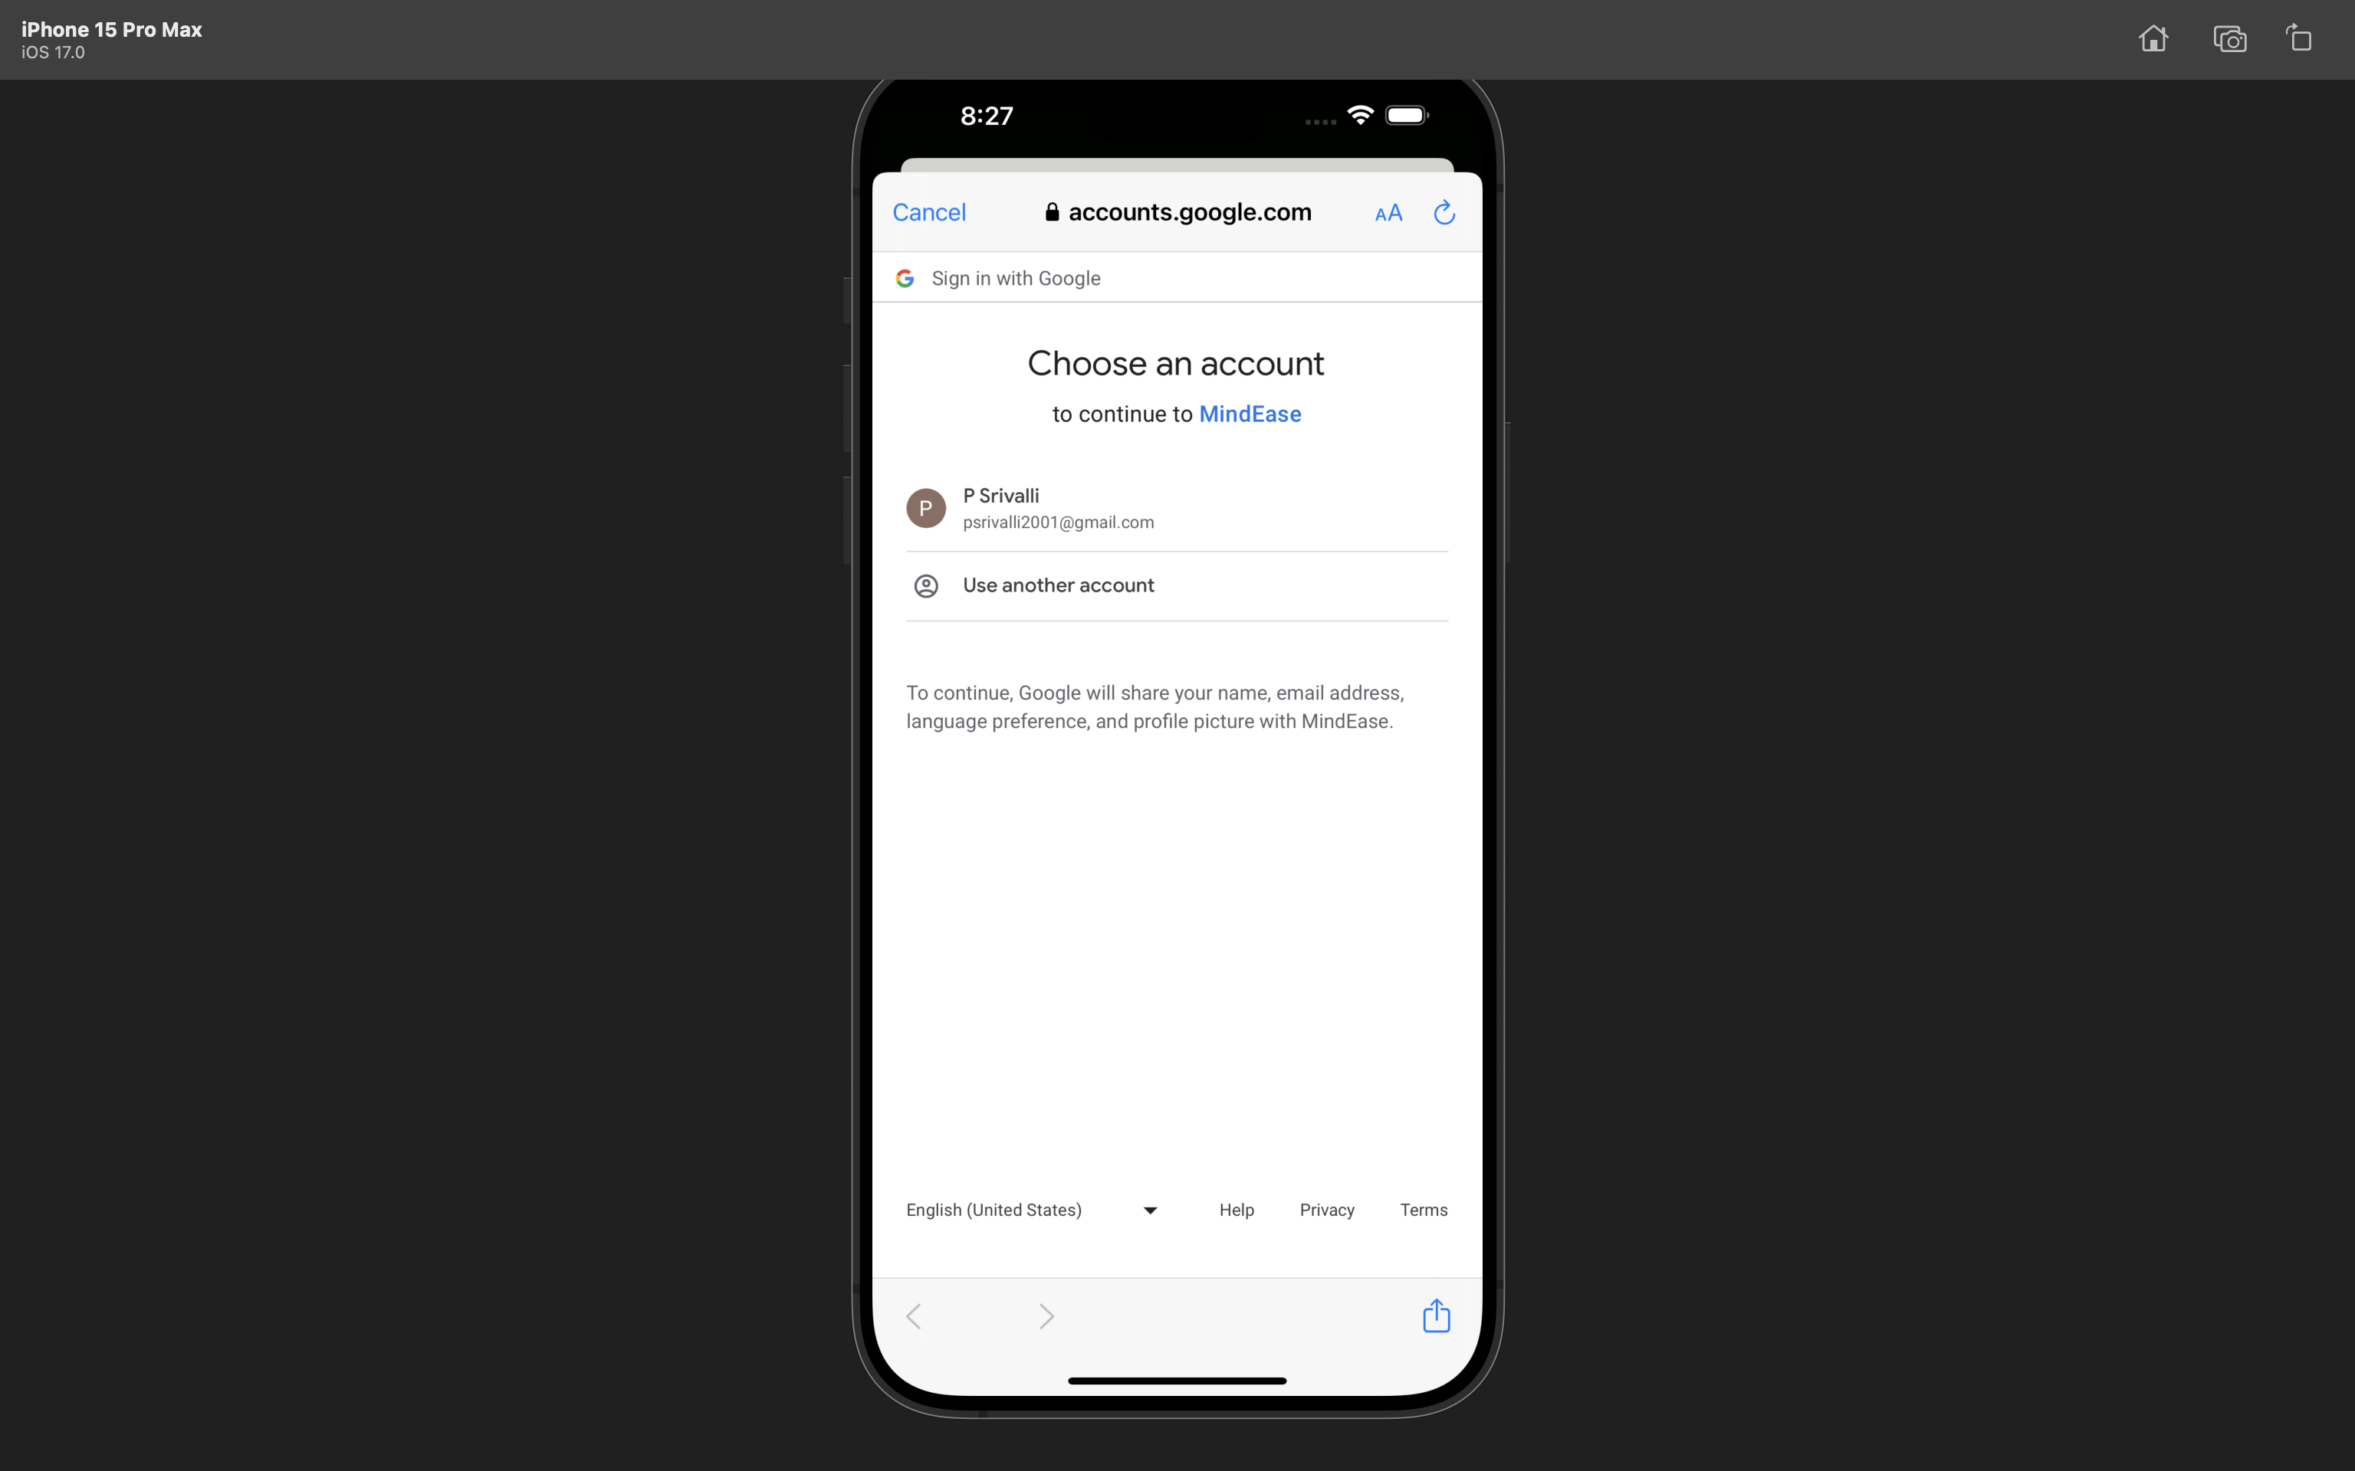
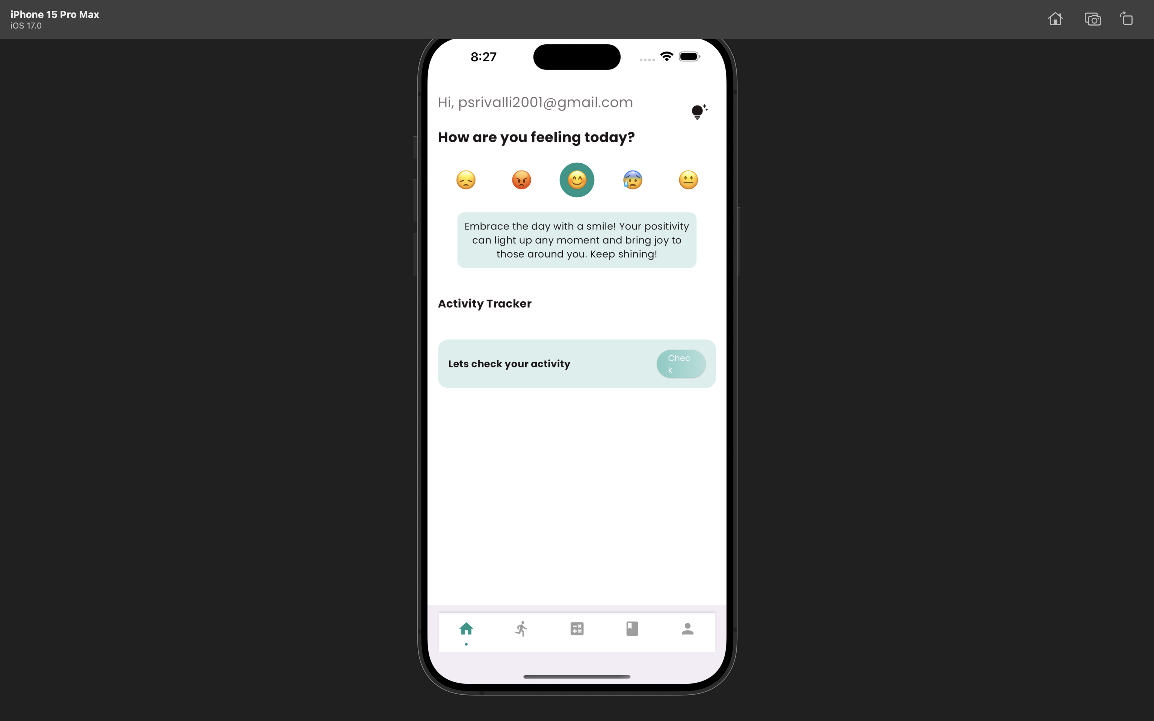
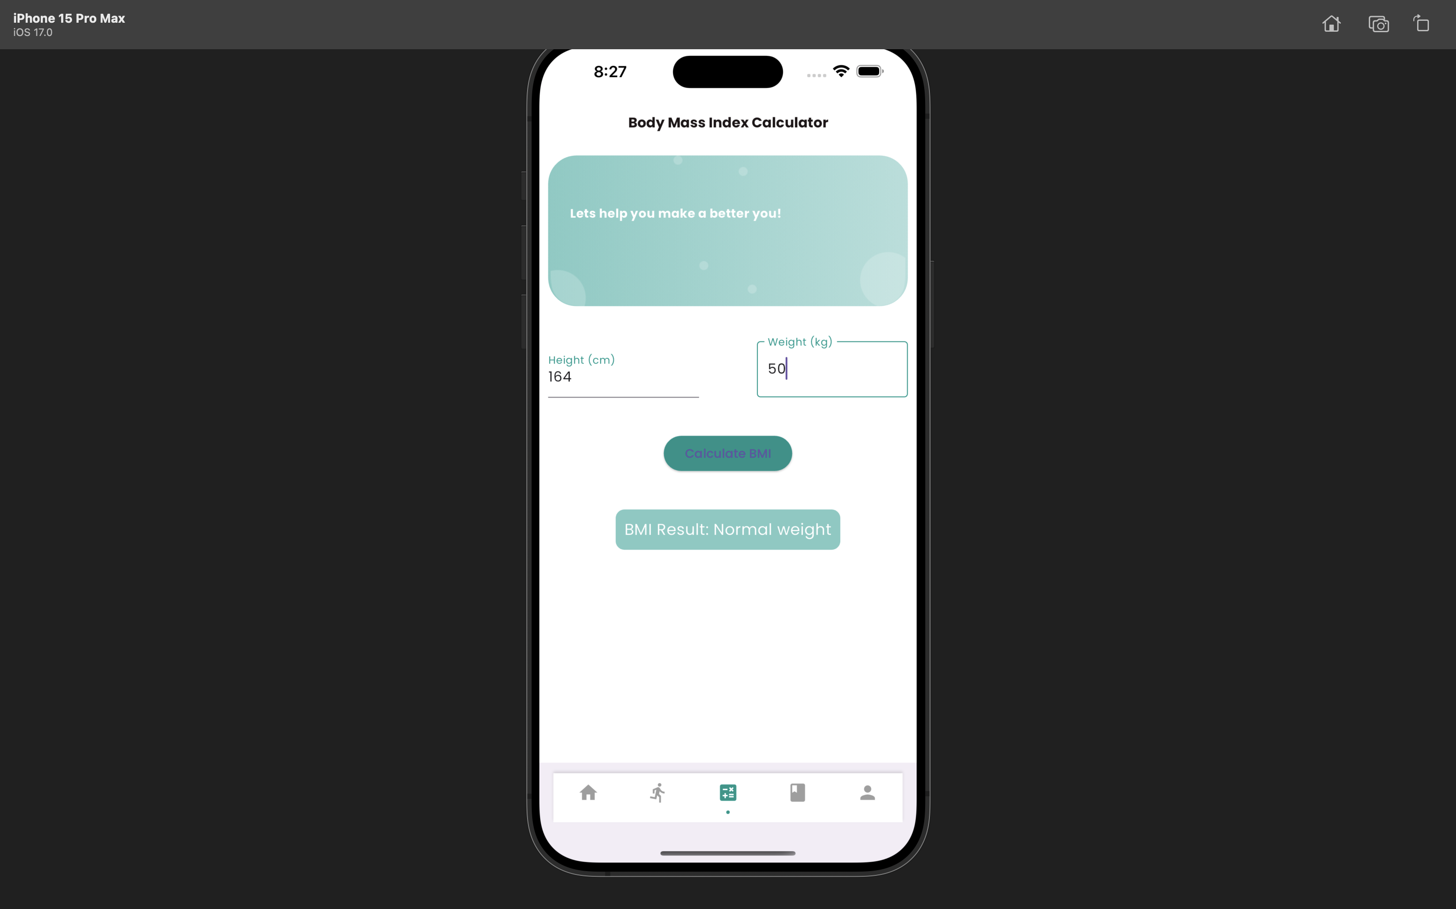
Screenshots

Slide 13
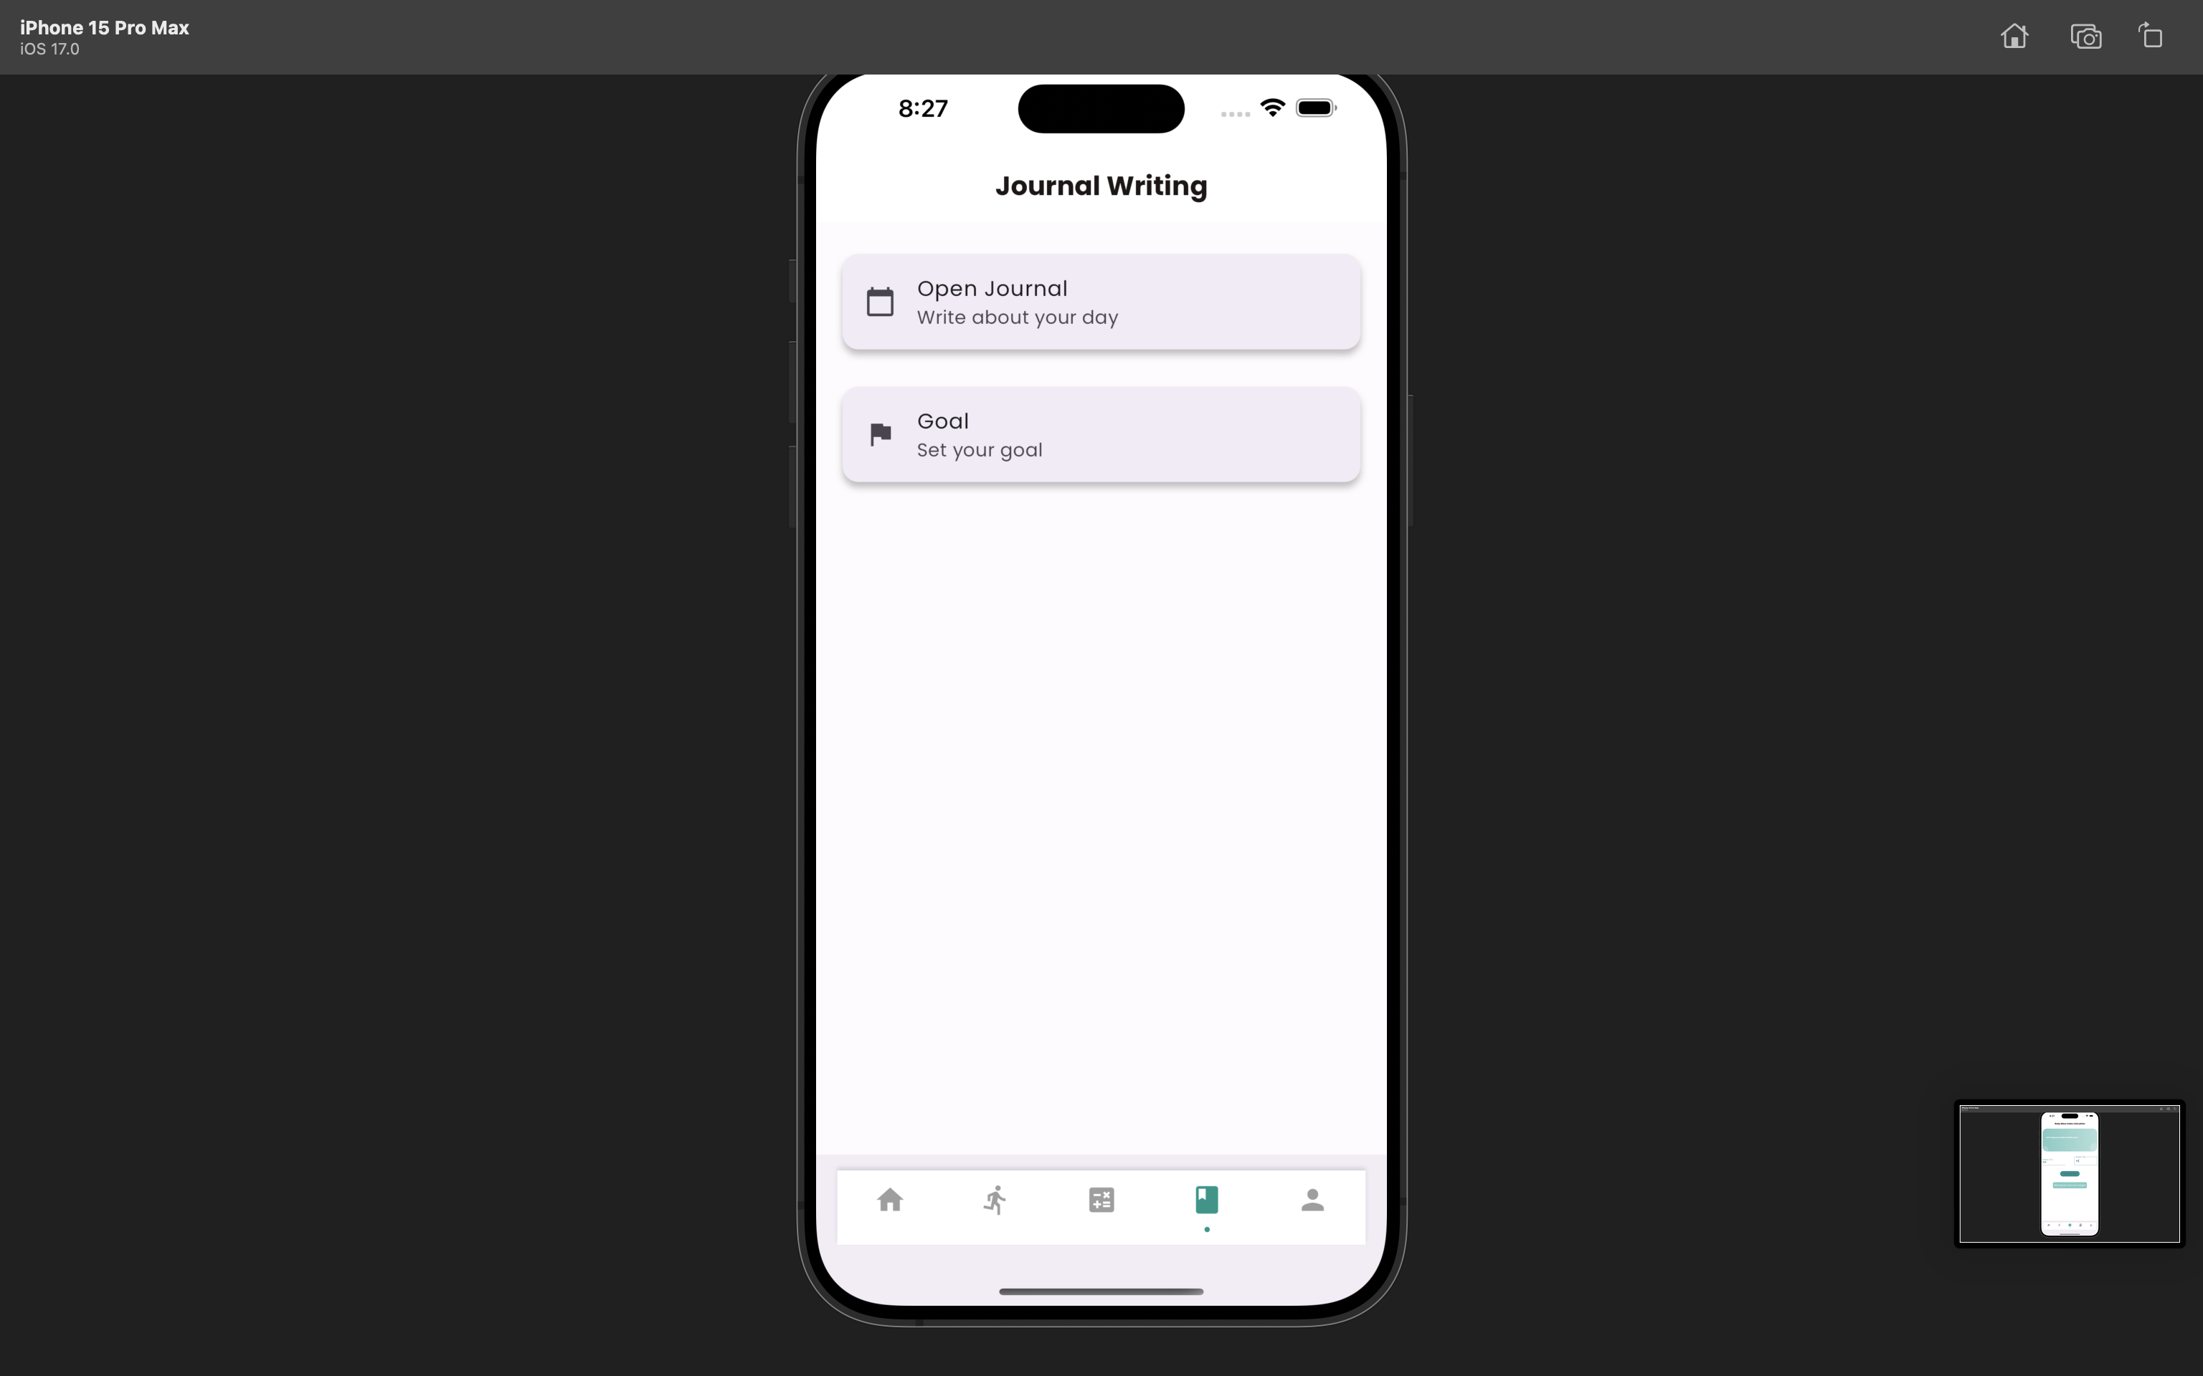
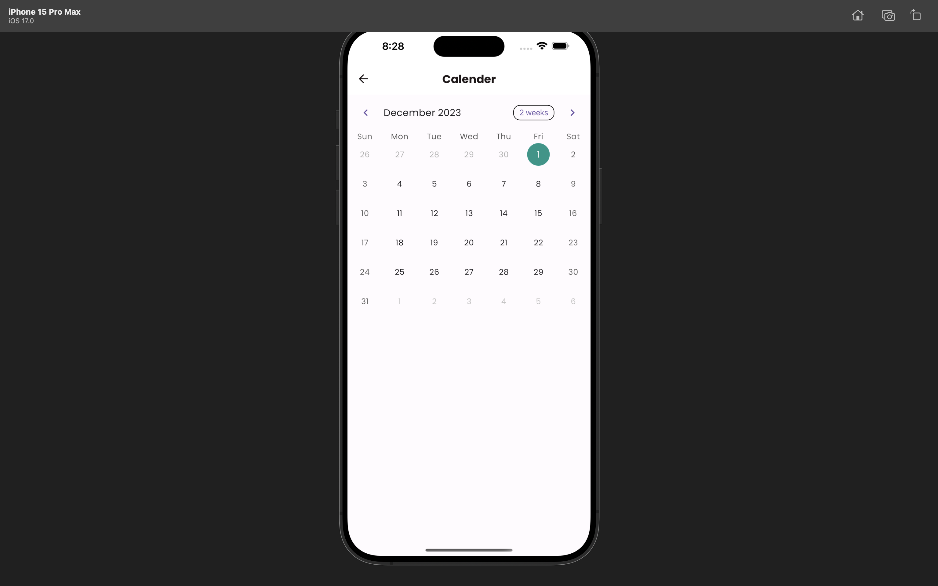
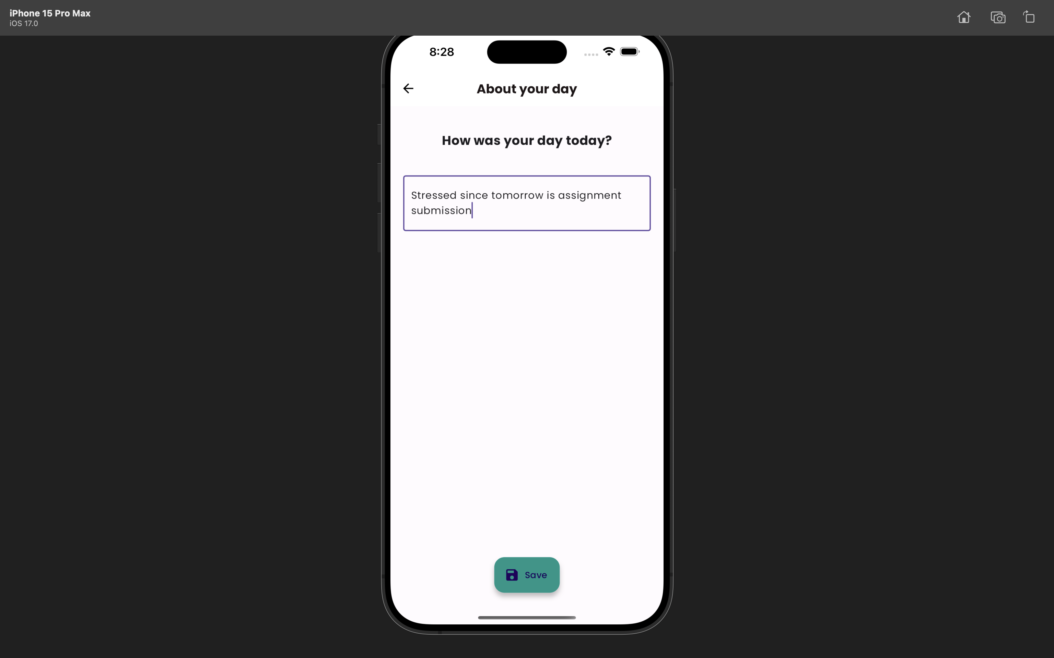
Screenshots

Slide 14
Challenges
Real-time Mood Tracking: Implementing a feature that allows users to track their mood in real-time could have posed challenges in terms of data accuracy, user interface responsiveness, and ensuring a seamless experience.
Data Privacy and Security: Managing sensitive user data, especially in features like journaling where personal thoughts are recorded, might have required robust security measures to safeguard user privacy.
Integration of Features: Integrating diverse functionalities like BMI calculation, mood tracking, journaling, and goal setting into a cohesive and intuitive app interface could have presented integration challenges, ensuring they work seamlessly together without overwhelming the user.
Cross-Platform Compatibility: Developing the app using Flutter for cross-platform functionality has come with challenges in ensuring consistent performance and UI/UX across different devices and operating systems.

Slide 15
Interesting Points
Visualization of Mood Patterns: Creating visualizations or analytics based on mood tracking data to provide users with insights into their emotional well-being over time could be an intriguing and unique aspect of MindBody.
User Engagement through Journaling: The feature allowing users to express themselves freely through journal entries might have fostered a strong user engagement aspect, encouraging self-reflection and mindfulness.
Goal Setting and Progress Tracking: The ability for users to set and track personal goals within the app might have a significant impact on motivation and personal development, fostering a sense of accomplishment.
Holistic Approach to Wellness: MindBody's comprehensive approach, addressing both physical (BMI) and emotional (Mood Tracker, Journaling) well-being, represents a holistic approach to mental health support within a single application.

Slide 16
THANK - YOU

